Slide 1
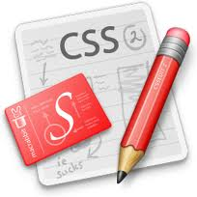
CSS
Lesson 15

Slide 2
CSS Media Types
With media types a page can have one layout for screen, one for print, one for handheld devices, etc.
Media Type | Description
all | Used for all media type devices
aural | Used for speech and sound synthesizers
braille | Used for braille tactile feedback devices
embossed | Used for paged braille printers
handheld | Used for small or handheld devices
print | Used for printers
projection | Used for projected presentations, like slides
screen | Used for computer screens
tty | Used for media using a fixed-pitch character grid, like teletypes and terminals
tv | Used for television-type devices

Slide 3
CSS Media Types
media Attribute
Value | Description
width | Specifies the width of the targeted display area. "min-" and "max-" prefixes can be used. Example: media="screen and (min-width:500px)"
height | Specifies the height of the targeted display area. "min-" and "max-" prefixes can be used. Example: media="screen and (max-height:700px)"
device-width | Specifies the width of the target display/paper. "min-" and "max-" prefixes can be used. Example: media="screen and (device-width:500px)"
device-height | Specifies the height of the target display/paper. "min-" and "max-" prefixes can be used. Example: media="screen and (device-height:500px)"
orientation | Specifies the orientation of the target display/paper. Possible values: "portrait" or "landscape" Example: media="all and (orientation: landscape)"

Slide 4
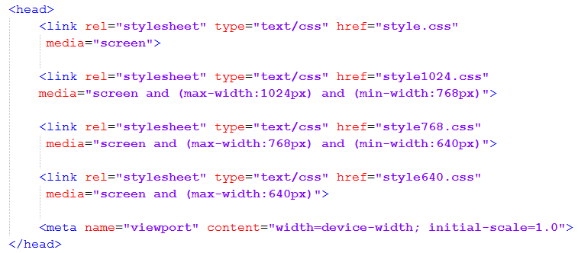
CSS Responsive Design

Slide 5
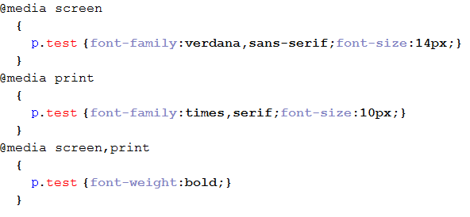
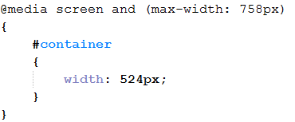
CSS Media Types
@media Rules

Slide 6

Task:
Min-width:1200px

Slide 7
Task:
Max-width:1200px and Min-width:1024px

Slide 8
Task:
Max-width:1024px and Min-width:768px

Slide 9
Task:
Max-width:768px and Min-width:640px

Slide 10
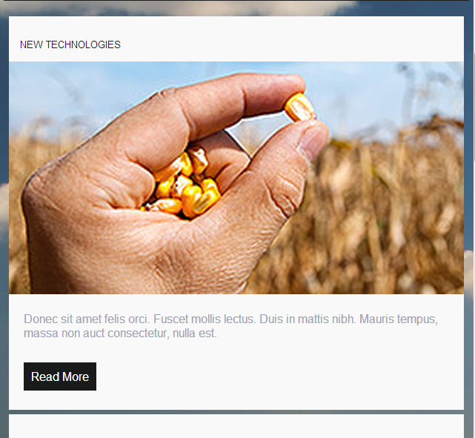

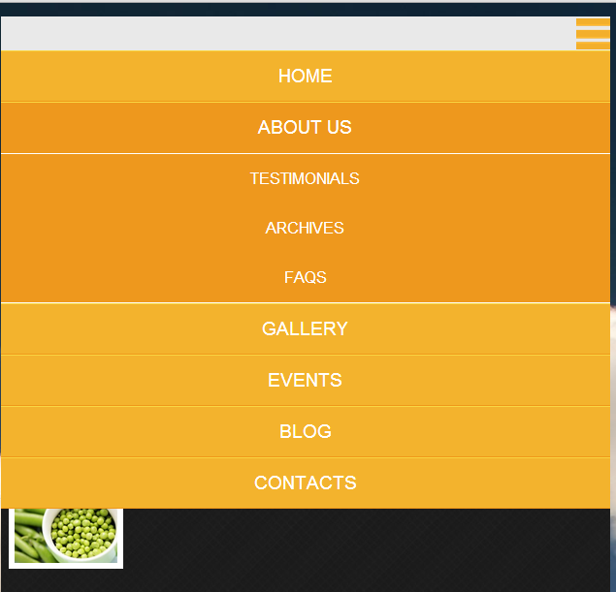
Task:
Max-width:640px

